Slide 1
NWEA Celebration Assembly
February 1, 2024

Slide 2
On February 1, 2024, Arno hosted its fifth annual NWEA Rewards Assembly. If a student made their personal reading/math goal, or achieved grade level or higher, they were honored with a certificate and an extra recess.
The top 10 scores from
each grade also received a certificate,
good for a movie with the principal.

Slide 3
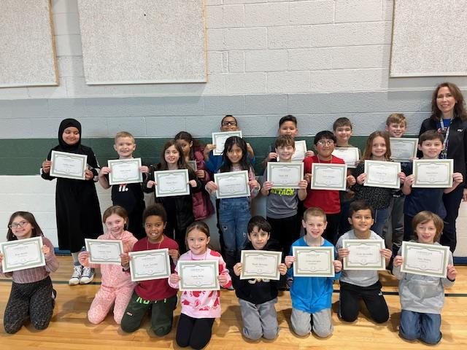
Mrs. Guyot’s 3rd Grade Class

Slide 4
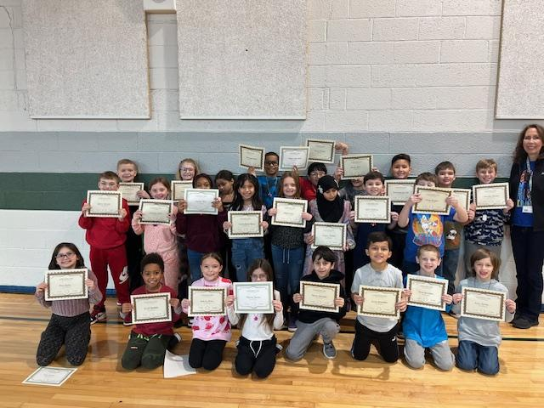
Mrs. Guyot’s 3rd Grade Class

Slide 5
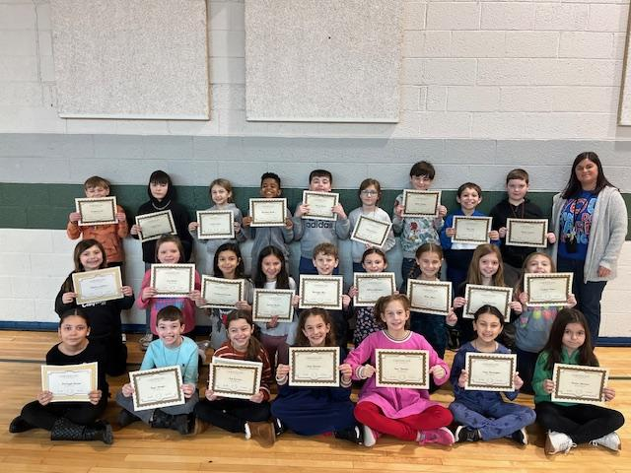
Mrs. Kalis’s 3rd Grade Class

Slide 6
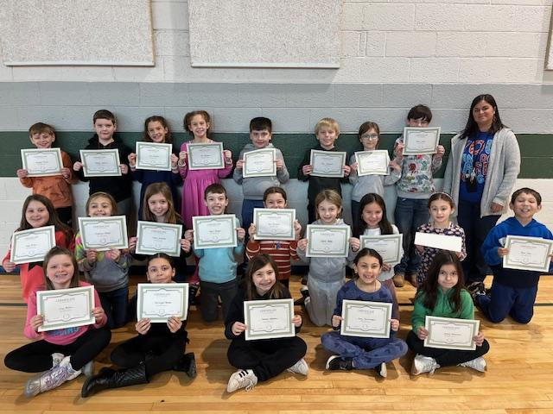
Mrs. Kalis’s 3rd Grade Class

Slide 7
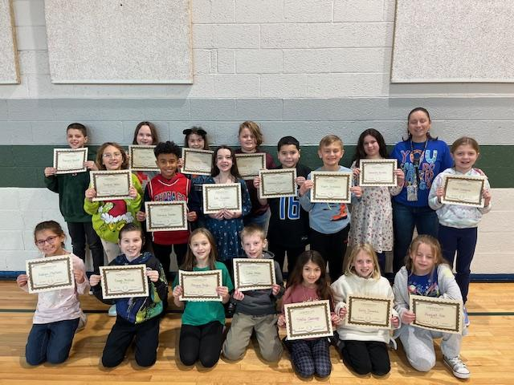
Mrs. Warneck’s 3rd Grade Class
Math

Slide 8
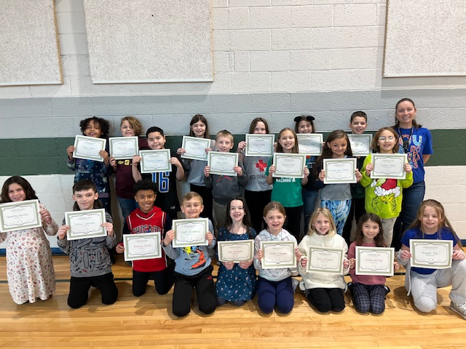
Mrs. Warneck’s 3rd Grade Class

Slide 9
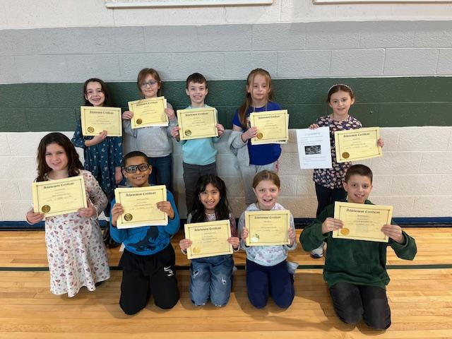
Top Ten 3rd Grade
Reading

Slide 10
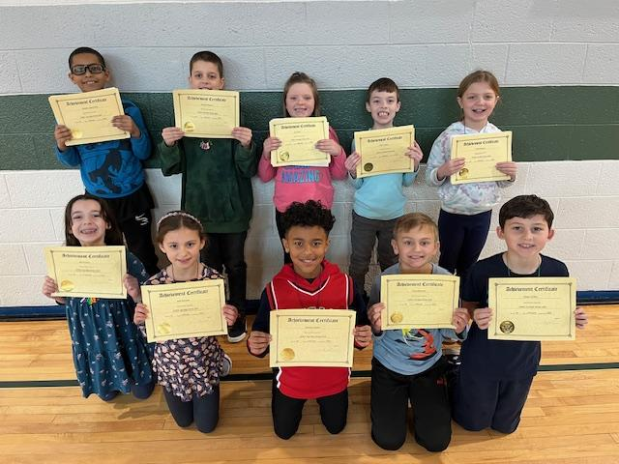
Top Ten 3rd Grade
Math

Slide 11
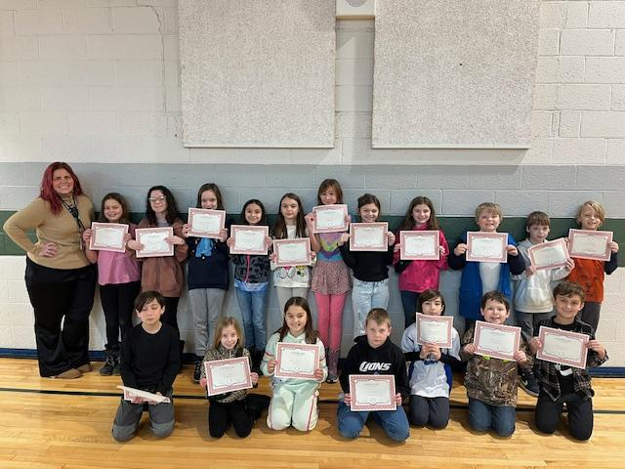
Mrs. Talamonti’s/Reese 4th Grade Class

Slide 12
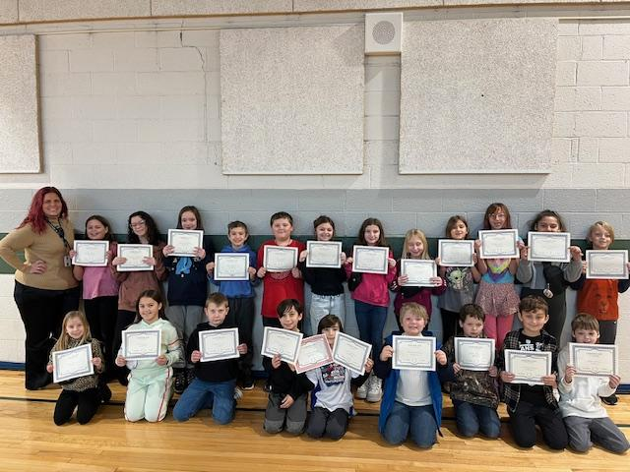
Mrs. Talamonti’s/Reese 4th Grade Class

Slide 13
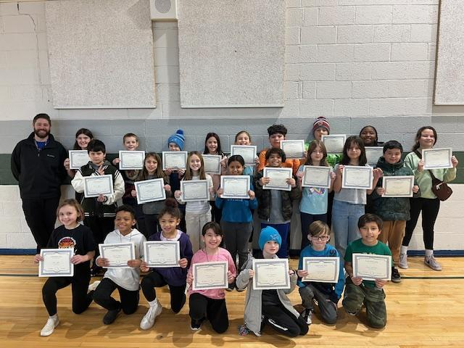
Mr. Huntington’s 4th Grade Class

Slide 14
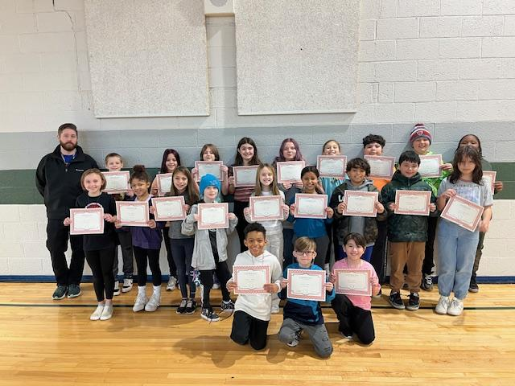
Mr. Huntington’s 4th Grade Class

Slide 15
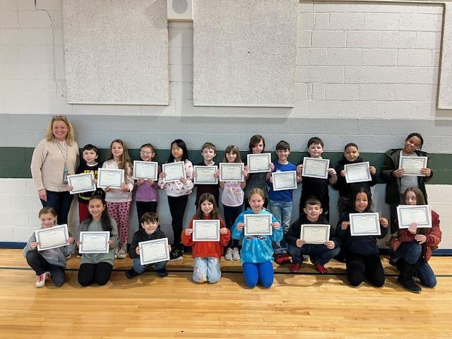
Mrs. Bleau’s 4th Grade Class

Slide 16
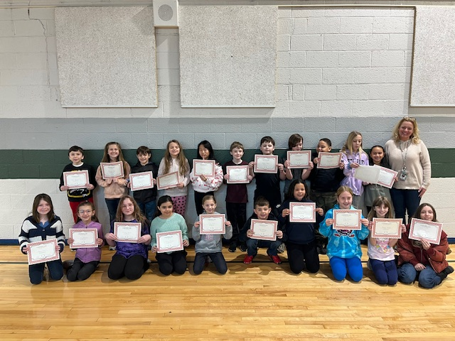
Mrs. Bleau’s 4th Grade Class

Slide 17
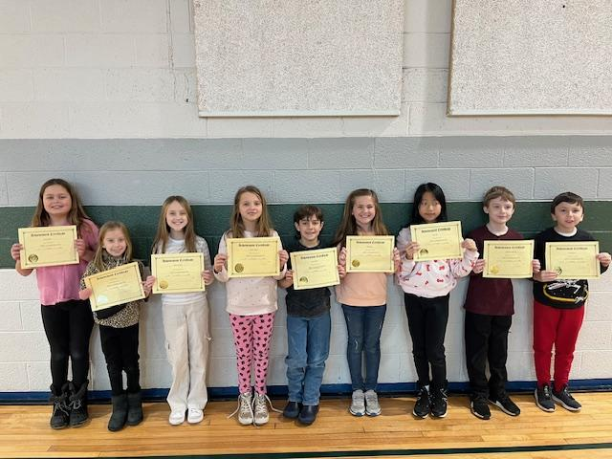
Top Ten 4th Grade
Reading

Slide 18
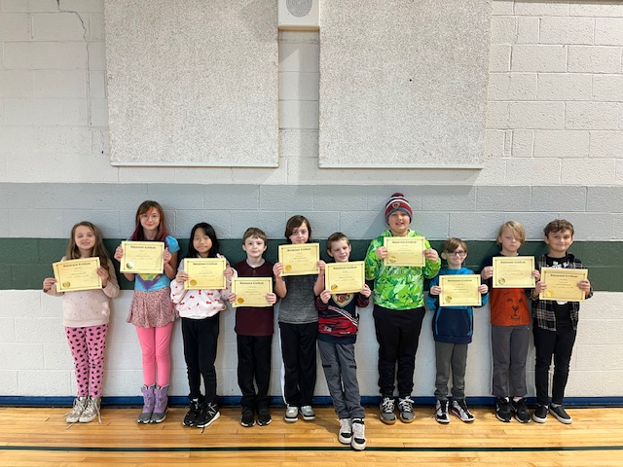
Top Ten 4th Grade
Math

Slide 19
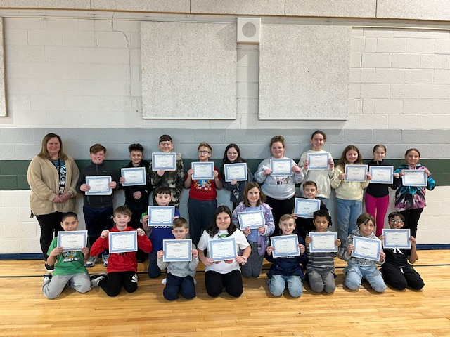
Ms. Higgins 5th Grade Class

Slide 20
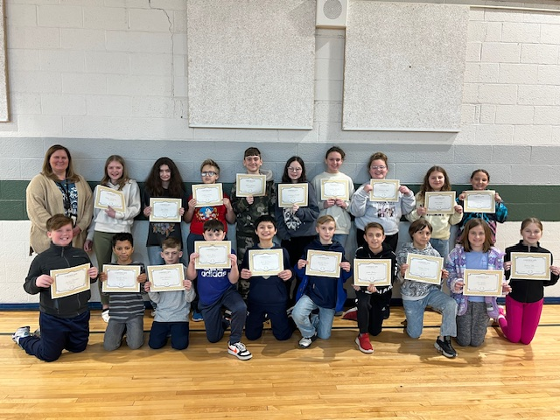
Ms. Higgins 5th Grade Class

Slide 21
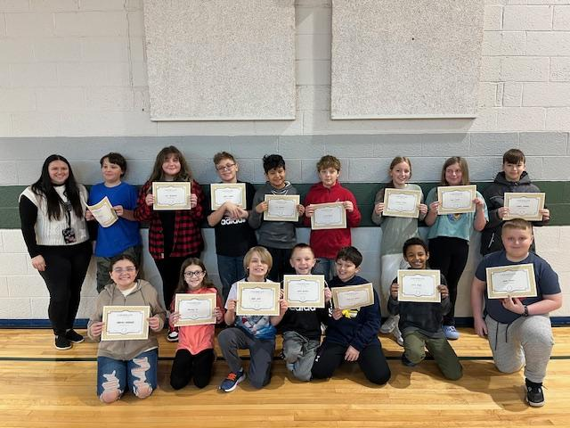
Mrs. Garza’s 5th Grade Class

Slide 22
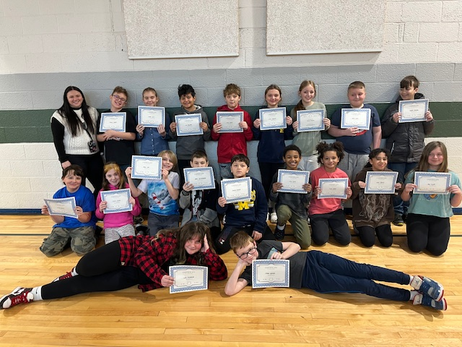
Mrs. Garza’s 5th Grade Class
Math

Slide 23
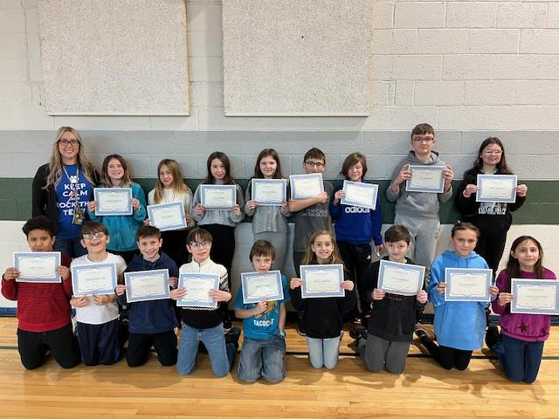
Ms. Zuke’s 5th Grade Class

Slide 24
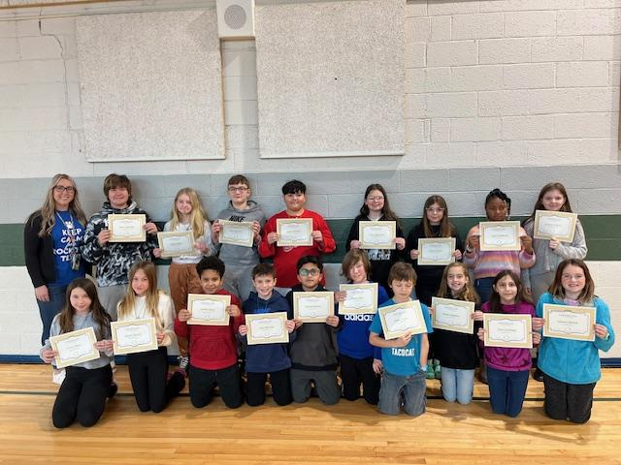
Ms. Zuke’s 5th Grade Class

Slide 25
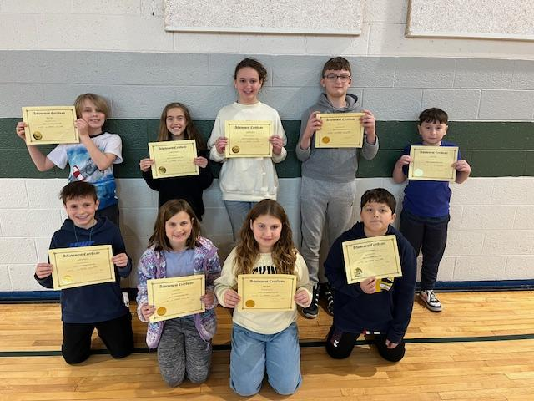
Top Ten 5th Grade
Reading

Slide 26
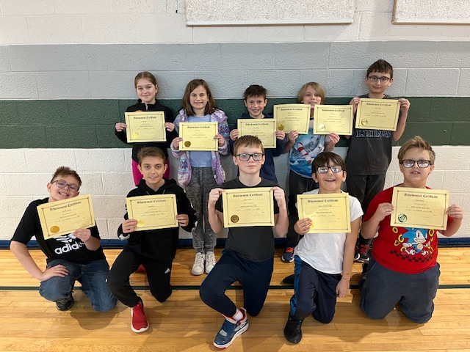
Top Ten 5th Grade
Math

