Slide 1
ThinkCentral Resources
Log onto your ThinkCentral account.
Click on Resources within your dashboard.
These are the resources you have access.
The next slide shows what your page should look like.

Slide 2
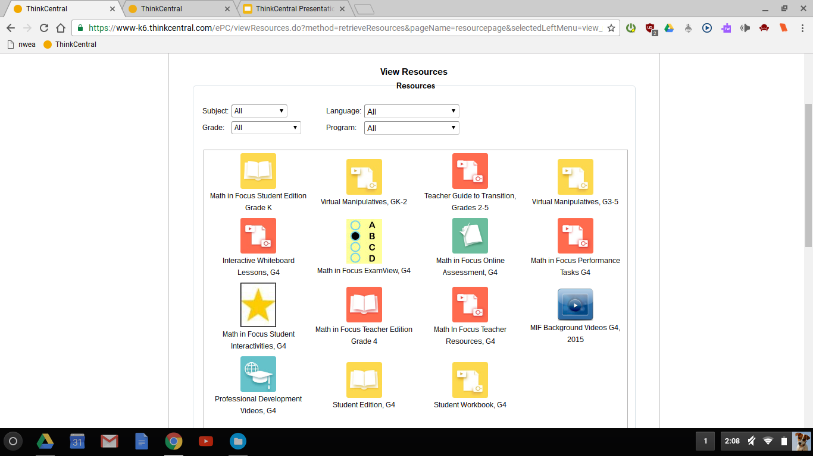

Slide 3
ThinkCentral Resources
Yellow icons represent items that students can access online. Red icons are for teachers only.
Student Edition- This is where you will find pages from the students’ hardcover book.
Student Workbook- This is where you will find pages from the students’ softcover book.
MIF Background Videos- This includes videos for students, parents, and teachers to view which cover basic concepts and tips for each chapter.
Virtual Manipulatives- This allows students practice concepts through virtual activities.
Math in Focus Student Interactivities- This gives students tutorials, activities, and quizzes based on different lessons from each chapter of their book.

Slide 4
Assigning Assessments
From the dashboard, click on “assignments” and under the “Assignment List”, click “add test”
In the search box, type in which chapter you want assign as your test. Ex.) Chapter 2
Under “Online Assessment” for the chapter you are assigning, select the “Assign” icon.
Your screen should look like the next slide.

Slide 5
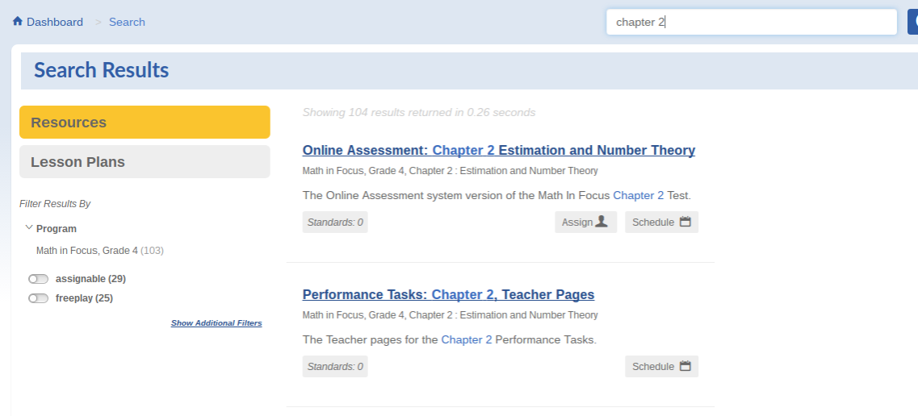

Slide 6
Assigning Assessments
This will bring up a new page titled “Add Test”
Under class, select your class name.
Next, select “add all” to add your students for the test.
Under “Add Test”, you will need to name your assessment.

Slide 7
Assigning Assessments
You can choose the dates to take the test as well as the time frame they take it within.
Under “Assessment Settings” click on “Select Questions”. This is where you can pick and choose which questions you want to assign for the test. Then, click “save”.
This assessment will now show up when the student logs in under their “assignments” tab.
The next slide shows the “Assessment Settings” section.

Slide 8
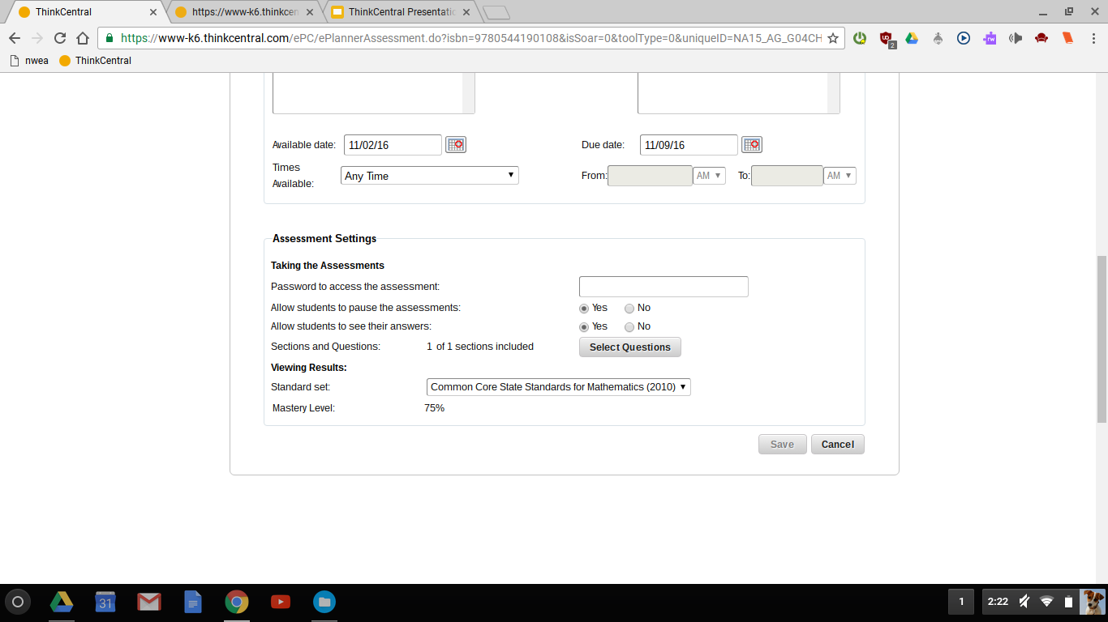
Assigning Assessments

Slide 9
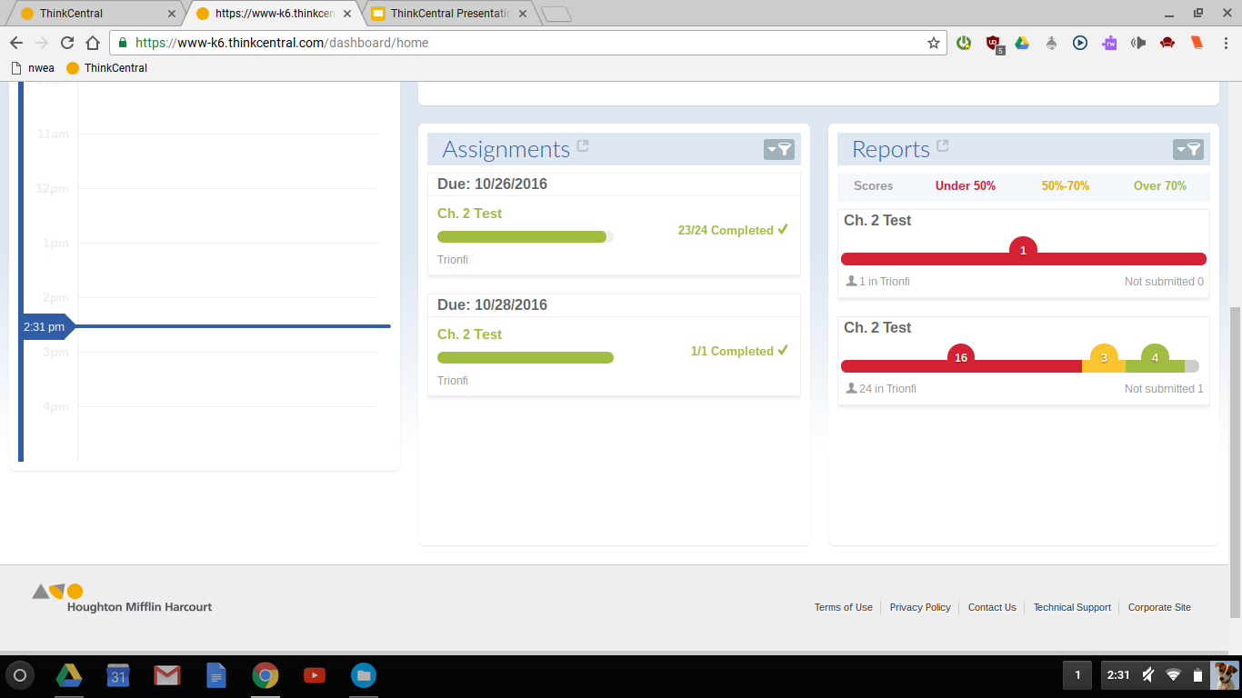
Accessing Data
There are two different ways to access data: Assignments or Reports

Slide 10
Accessing Reports
Click on Reports
Under the filters, go to where you can select your grade and subject (math).
Click on “Apply”
Select which assessment you want to view reports for. You have to have already given the assessment in order to view the report.
Click “Generate”
You can choose between “Assessment Reports”, “Comparisons”, or “Standards”.
Under CLASS find your name, click, that will show each student’s results.

Slide 11
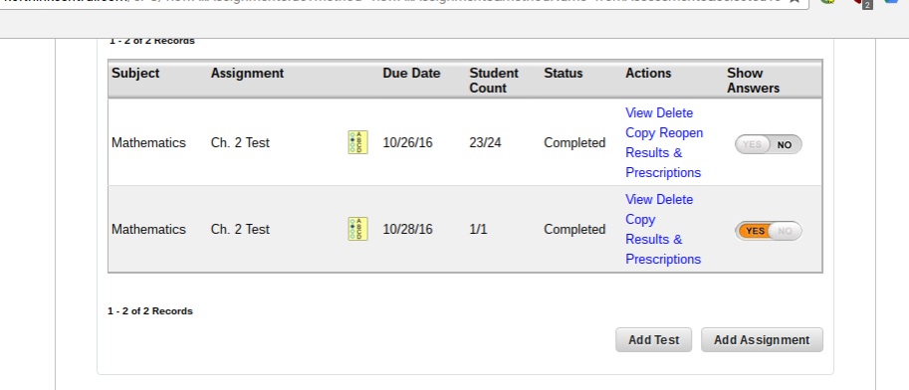
Accessing Results through Assignments
Find assessment, click on Results and Prescriptions
Your class list will show up with basic percentage scores
You can export to pdf and print off a report
You can go to manage scores and see each student’s results for each specific question.

Slide 12
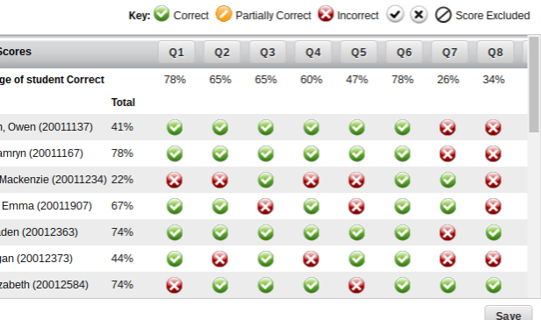
Accessing Results through Assignments
You can go to manage scores and see each student’s results for each specific question. This is what you should see below.

Slide 13
ThinkCentral Presentation
For any further questions ask, please go the shared ThinkCentral document where you can type in any questions you have after the session today.

